Slide 1
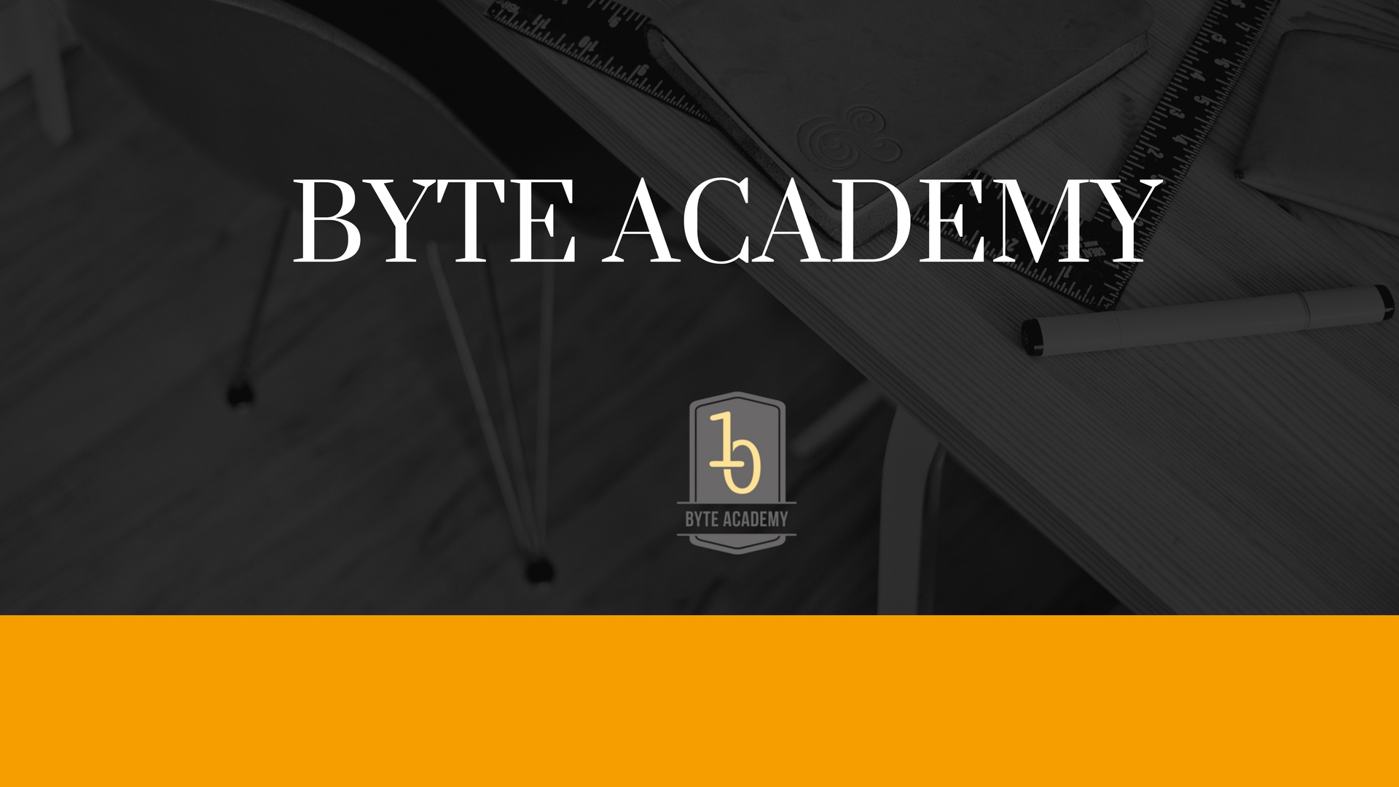

Slide 2
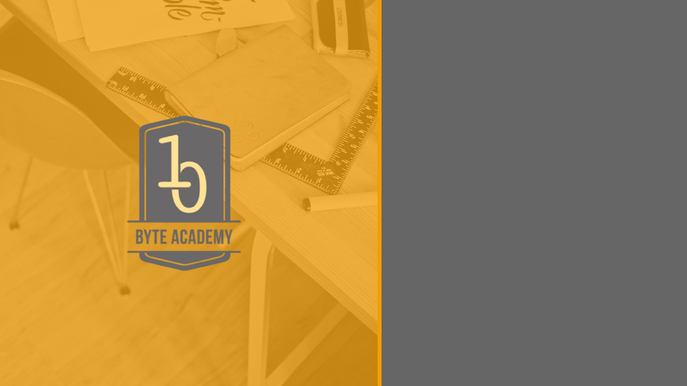
MVC and Python

Slide 3
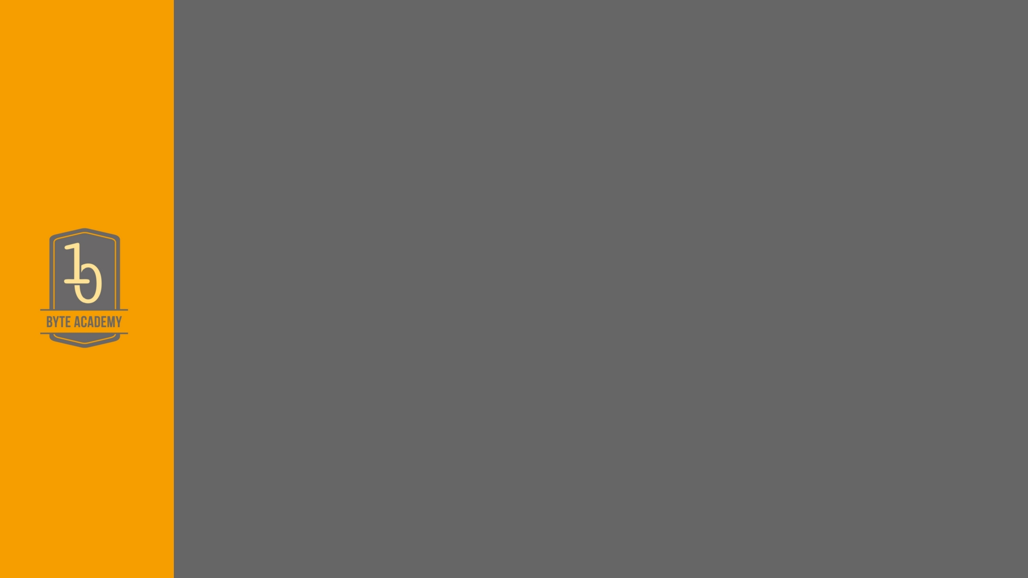
What is MVC?
MVC is a widely used software architectural pattern in GUI-based applications. The idea is to separate the internal representation of the data from the way it is presented to the user.
There are others, MVP(Presenter), MVVM, but the most common one is MVC.
So, what do the model, controller and view, respectively, do?

Slide 4
Model?
The model component of the MVC architecture represents the data of the application. It also represents the core business logic that acts on such data. The model has no knowledge of the view or the controller. When the data in the model changes, it just notifies its listeners about this change. In this context, the controller object is its listener.

Slide 5
View
The view component is the user interface. It is responsible for displaying the current state of the model to the user, and also provides a means for the user to interact with the application. If a user action (like the click of a button) changes this state, the view is refreshed to display that change.

Slide 6
Controller
The controller is responsible for responding to the user input and perform interactions on the data model objects. The controller receives the input, optionally validates the input and then passes the input to the model.
Notes:
Suppose we log on to HDFC nebanking. Right now the webpage is my views and I can input my username and password. The controller, will take in this input and send it to the model to check to see if any such account exists. Since the controller import the model and the view. So in this case, the view would have some input() statements, the model some sql query statements, and the controller the function which takes in the input and pushes it to the model for the query string.

Slide 7
Controller
VIEWS
USER
Controller
MODEL

Slide 8
Two other things
Right now we are missing two things, a module which actually creates the db. In ours case, the db is not pre-existing but needs to be specified. This is called the ORM.
The other, is a module which mangages where our data comes from, maybe an API. This is called the wrapper.
Notes:
Suppose we log on to HDFC netbanking. Right now the webpage is my views and I can input my username and password. The controller, will take in this input and send it to the model to check to see if any such account exists. Since the controller import the model and the view. So in this case, the view would have some input() statements, the model some sql query statements, and the controller the function which takes in the input and pushes it to the model for the query string.

Slide 10


